Slide 1

FACULTY OF INFORMATION TECHNOLOGY
Sea Level Rise Prediction System

Slide 2
Presented by :
Supervised by:
Omar Khaled 94144
Mohamed Shaban 94137
Moamen Ahmed 94245
Asmaa Mohamed 86346
Dr / Ahmed Fouad
TA / Eng. Mariam fared
TA / Eng. Mohamed omar

Slide 3

Agenda
Introduction
Possible Beneficiaries
Motivation
Main Objectives
SDG’s Goal
Related Works
Problem Definition
Proposed System
System Architecture
Methodologies and Techniques
System Requirements (S/W and H/W Tools)
Results and Outcomes
System Validation
Conclusion
References

Slide 4
Introduction
Climate change represents one of the major global issues to be addressed in the coming years. It can be considered as the “issue of our time”.
The Sea level rises for several reasons like heatwaves, heavy rain, fires, coastal flooding, and as temperature increases, ice melts and it contributes in increasing the sea level.
The consequences of sea level rise are far-reaching and encompass a range of challenges, including increased coastal erosion, the submergence of low-lying areas, and heightened vulnerability to extreme weather events and storm surges.

Slide 5
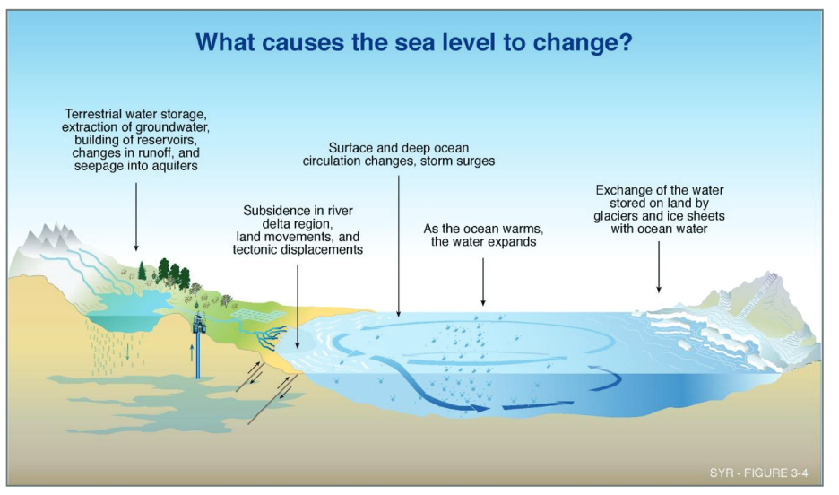
Introduction

Slide 6
Introduction
To effectively address these complex challenges, it is imperative to have accurate predictions of future sea level rise.
In recent years, machine learning has emerged as a powerful and innovative approach for analyzing complex environmental data and making precise predictions.
In this study, we express the potential of regression algorithms, including linear regression, random forest, decision tree, K-nearest neighbors, lasso regression, and ridge regression on our dataset that contains historical sea level data and relevant environmental factors.

Slide 7
Possible Beneficiaries
our system aims to assist
Policymakers:
Accurate sea level rise predictions can inform policymakers in developing effective mitigation and adaptation strategies.
urban planners and Engineers:
Accurate sea level rise predictions can benefit urban planners and engineers working on projects on coastal places to design resilient infrastructure, such as flood protection systems and coastal defenses to protect the area from upcoming danger.
coastal communities
Accurate sea level rise predictions can help coastal communities to prepare for future challenges such as Flooding which allow them to take decisions faster and safer for them and their business.

Slide 8
Motivation
The motivation behind this project Focuses on the significant increasing of sea level rise as a global environmental concern.
Understanding and predicting sea level changes are crucial for adapting to and mitigating the potential impacts on coastal regions.
By developing an accurate prediction system, we aim to contribute to
the scientific understanding of sea level dynamics as we use machine learning algorithms to analyze historical sea level data and relevant environmental factors.
support sustainable development practices by empowering stakeholders to make informed decisions and take proactive measures in response to the challenges of sea level rise.

Slide 9
Main Objectives
The objective of our system is to develop a machine learning-based sea level prediction system that can provide accurate predictions of future sea level rise.
By leveraging historical sea level data and relevant environmental factors, our system aims to assist policymakers, urban planners, and coastal communities in making informed decisions and implementing proactive measures to mitigate the adverse effects of rising sea levels.

Slide 10
SDG’s Goal
What is SDG?
SDG stands for Sustainable Development Goals, They are a set of 17 global goals established by the United Nations in 2015 Adopted by 193 countries in 2015.
The Sustainable Development Goals (SDGs) are the world’s shared plan to end extreme poverty, reduce inequality, and protect the planet by 2030.

Slide 11

SDG’s Goal
The 17 Sustainable Development Goals are:

Slide 12

SDG’s Goal
Our Project’s objectives aligns with the SDG Goal number 13 which is Climate Action
SDG Goal 13 focuses on taking urgent action to combat climate change and its impacts. It focuses on making appropriate decisions and adapting to climate-related disasters.
By developing an accurate sea level rise prediction system, Our project supports decision making to adapt with and prevent the damage that results from climate change and global warming to mitigate the adverse effects of rising sea levels.

Slide 13
Related Works
Machine learning methods applied to sea level predictions in the upper part of a tidal estuary
In this project They used machine learning to predict sea level in the upper part of tidal estuary in the harbor of Brest and the city of Landerneau
they used their input data from a dataset which is three-year observations of sea levels , they also used four inputs from other models French tidal coefficient, atmospheric pressure, wind velocity, and river discharge.
they used two types of machine learning algorithms:
multiple regression methods
an artificial neural network, the multilayer perceptron.

Slide 14
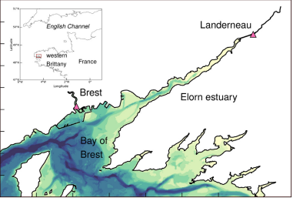
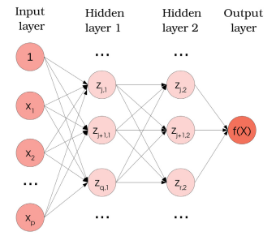
Related Works

Slide 15
Related Works
2. Sea Level Prediction Using Machine Learning, Department of Civil Engineering, Akdeniz University
In this project they used machine learning to predict the sea level rise in tide gauge in Antalya Harbor, Turkey.
they used their input data as sea level observations, and both sea level and meteorological factor observations.
They used Multiple linear regression (MLR) and Adaptive Neuro-Fuzzy Inference System (ANFIS) which is neural networks combined with fuzzy logic linguistic IF-THEN rules.

Slide 16
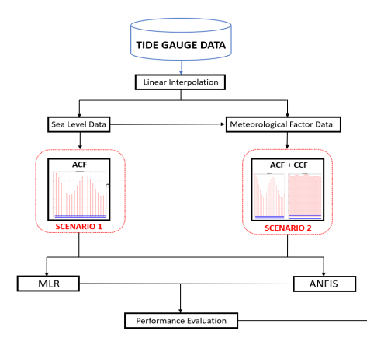

Related Works

Slide 17
Related Works
3. Time-Series Prediction of Sea Level Change in the East Coast of Peninsular Malaysia from the Supervised Learning Approach
In this project they used machine learning to predict the changes in the sea level on the east coast of Peninsular Malaysia.
for the period from January 2007 to December 2017, The selected inputs for the proposed model are:
monthly mean sea level (MMSL),
monthly sea surface temperature (SST),
rainfall
mean cloud cover (MCC)
They used regression support vector machine (RSVM) as for their machine learning algorithm.

Slide 18
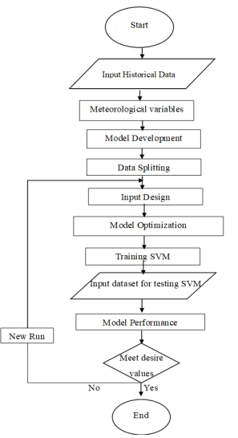
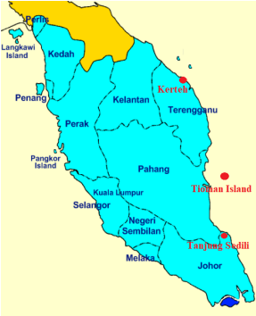
Related Works

Slide 19
Problem Definition
In recent years, the escalating rise in global sea levels has become a matter of great concern as sea level is rising more than twice as fast in recent decades than it did earlier in the 20th century.
Many coastal communities are already seeing effects of rising seas. Therefore, We decided to apply machine learning algorithms on our dataset that contains historical sea level data and relevant environmental factors to perform an Accurate prediction of sea level.
the purpose of Accurate prediction of sea level is important to avoid any possible damage to the coastal region like flooding, coastal erosion and infrastructure damage .

Slide 20
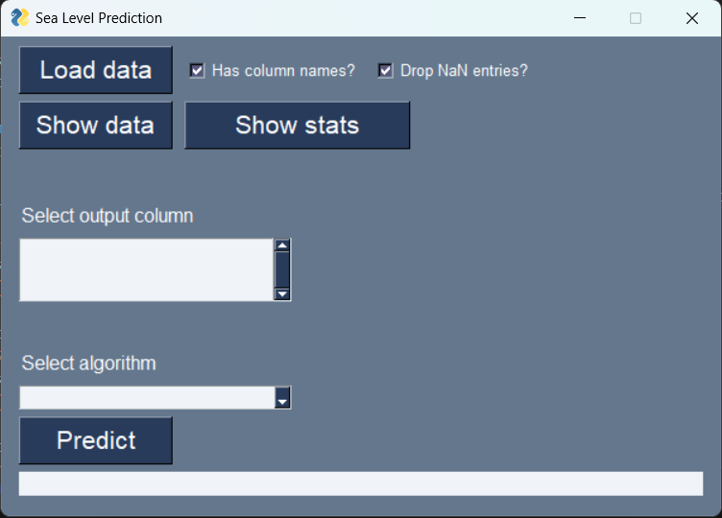
Proposed System
I. Main Screen

Slide 21
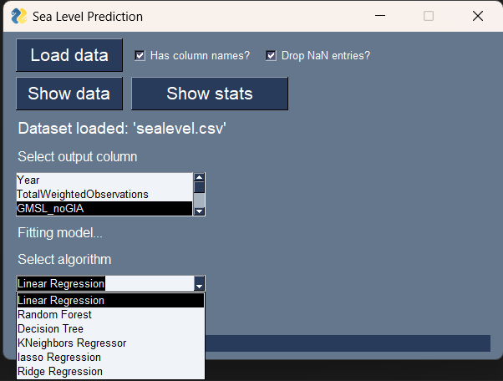
Proposed System
II. Main Screen with Algorithms of uploaded dataset

Slide 22
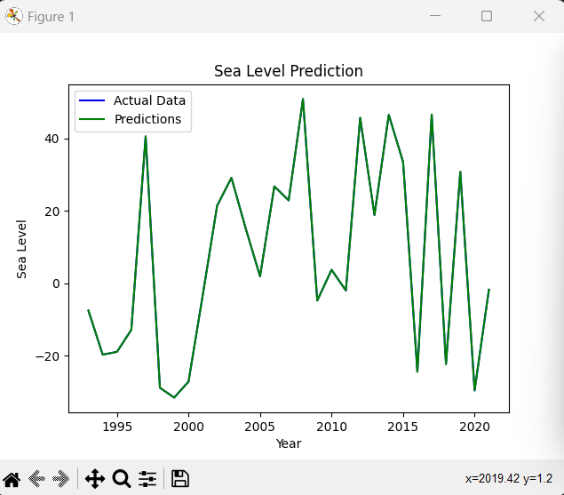
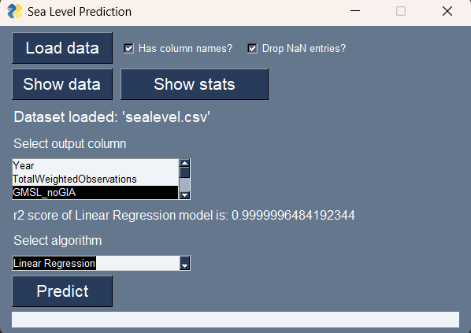
Proposed System
III. Result Of Choosing Linear Regression Algorithm and the right output column

Slide 23
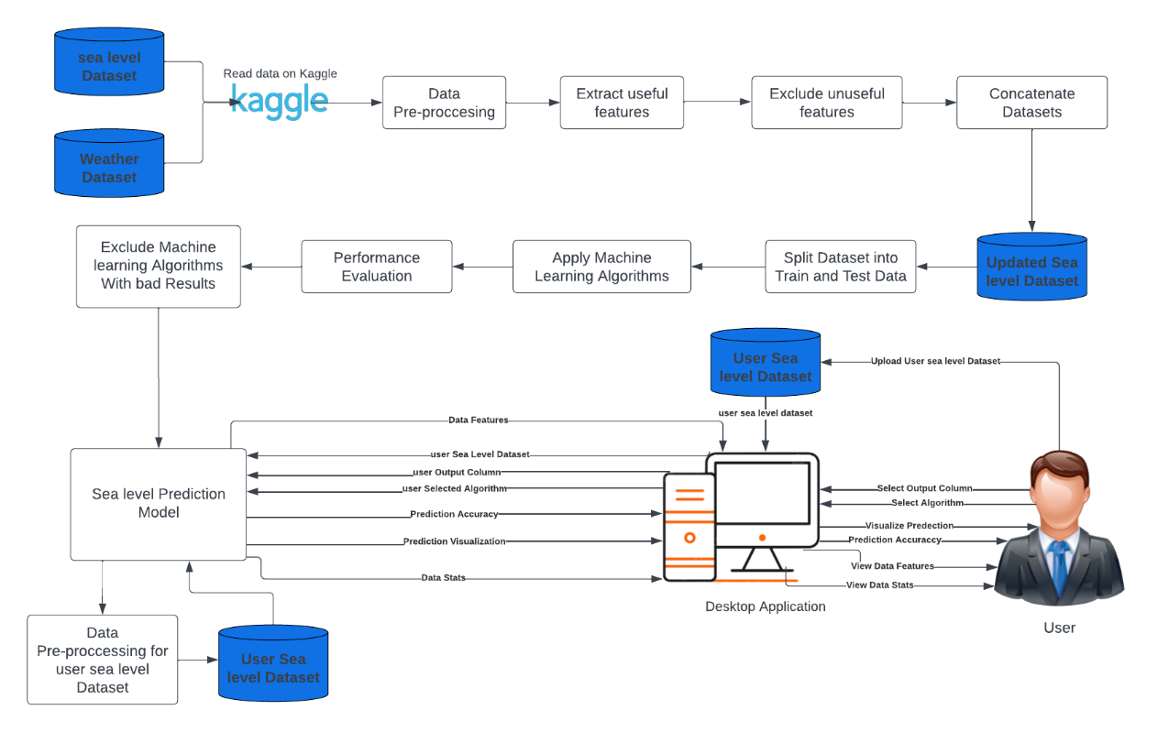
System Architecture

Slide 24
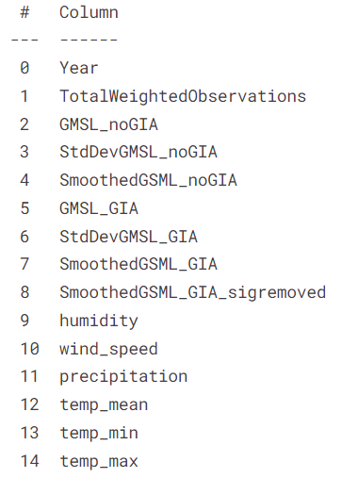
Methodologies and Techniques
Global Sea level Dataset
Weather Dataset

Slide 25
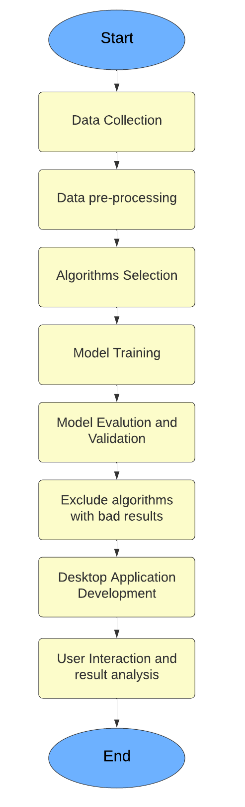
Methodologies and Techniques
Project Methodology

Slide 26
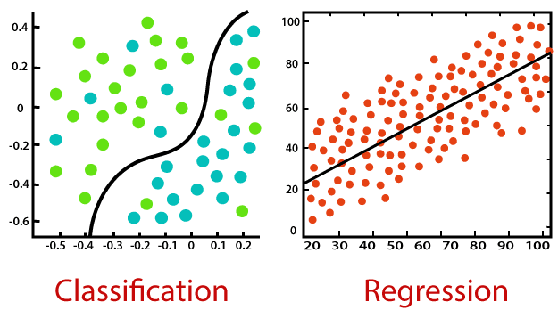
Methodologies and Techniques
In our project on predicting sea level rise using machine learning, we have implemented several algorithms, methodologies, and techniques to analyze and forecast sea level data. all of them are Supervised machine learning algorithms used for regression.

Slide 27
Methodologies and Techniques
In our project on predicting sea level rise using machine learning, we have implemented several algorithms, and here are the algorithms that we used in our sea level prediction system:
Linear Regression
Decision Tree
Random Forest
K-nearest neighbor (KNN)
Ridge Regression
Lasso Regression

Slide 28




System Requirements (S/W and H/W Tools)
Software Requirements:

Slide 29
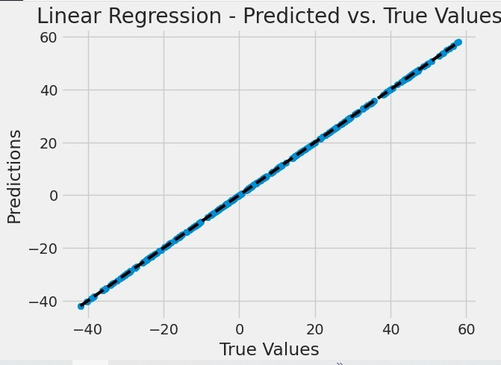
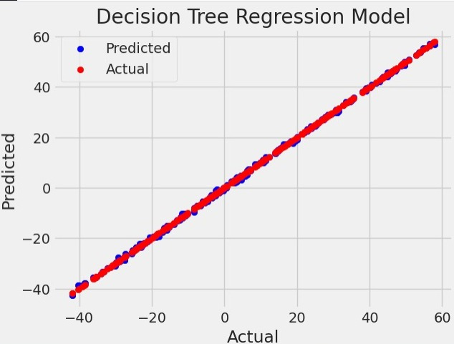
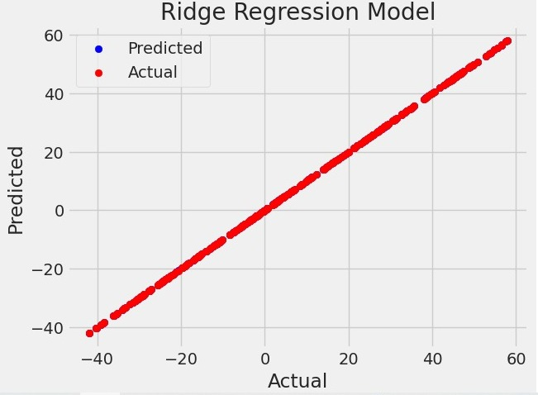
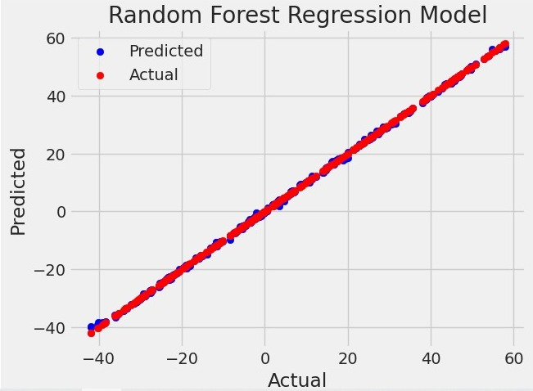
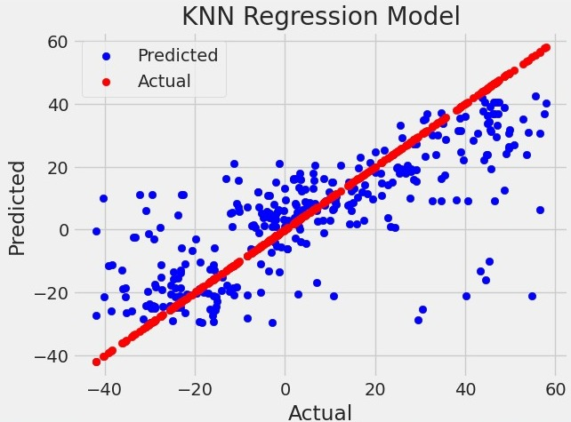
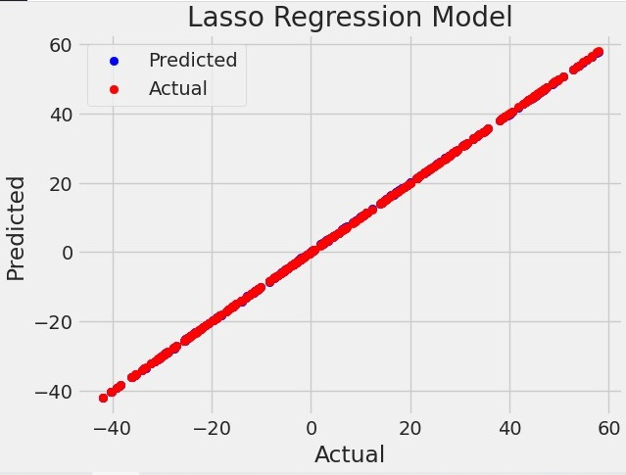
Results and Outcomes

Slide 30
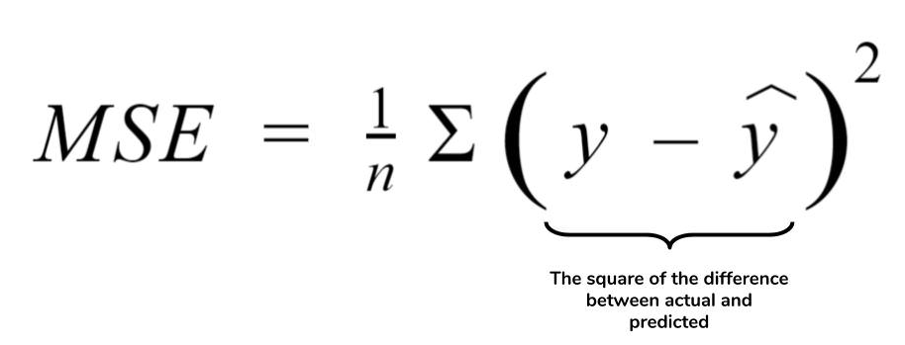
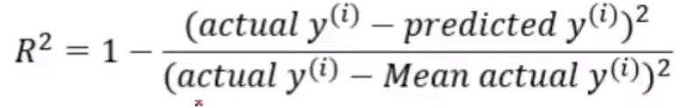
Results and Outcomes
Our Evaluation matrices:

Slide 31
Results and Outcomes
Algorithm | Mean Square Error | R2
Linear regression | 1.25050271257065E-21 | 1
Random Forest Regression | 0.0831380939999992 | 0.999876368586016
Decision tree Regression | 0.12162697089947 | 0.999819133279735
K-Nearest Neighbors Regression | 266.851836101587 | 0.6031750520857
Ridge Regression | 0.00025587564459585865 | 0.999999619497318
Lasso Regression | 0.009603885490539671 | 0.9999857184368104

Slide 32
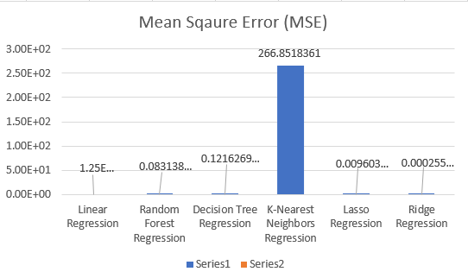
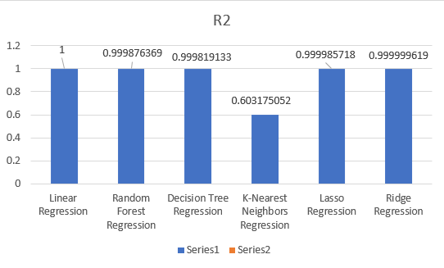
Results and Outcomes

Slide 33
System Validation
Here are The comparison between r2 score of the Model and r2 score of the Desktop Application.
Algorithm | R2 of model | R2 of Desktop App
Linear regression | 1 | 0.9999996484192344
Random Forest Regression | 0.999876368586016 | 0.9996361459330564
Decision tree Regression | 0.999819133279735 | 0.9995900629364399
K-Nearest Neighbors Regression | 0.6031750520857 | 0.58007973023154
Ridge Regression | 0.999999619497318 | 0.9999996194973179
Lasso Regression | 0.9999857184368104 | 0.9999857184368104

Slide 34
System Validation
The r2 score of the model and the desktop application are close to each other for each algorithm, that indicates that our system shows reliable performance as the predictions generated by the application are consistent with the model's performance, reinforcing the reliability of the system.

Slide 35
Conclusion
Our results demonstrate the effectiveness of machine learning in predicting sea level rise.
Linear Regression, Random Forest Regression, Decision Tree Regression, Ridge Regression, and Lasso Regression showed promising performance in capturing the underlying patterns and predicting future sea level changes.
Particularly, Linear Regression achieved the best performance with perfect R2 score and an extremely low MSE, indicating a close fit between the predicted and actual sea level values.

Slide 36
Conclusion
These findings highlight the potential of machine learning algorithms in aiding our understanding of sea level rise and its impacts.
The accurate prediction of sea level changes can contribute to informed decision-making and help in formulating effective adaptation and mitigation strategies.
We also made a Desktop application To help user to input his dataset and apply those algorithms on it.

Slide 37
References
NASA Climate. (n.d.). Sea Level 101: Part Two - All Sea Level is Local. NASA's Global Climate Change: Vital Signs of the Planet. Retrieved from https://climate.nasa.gov/explore/ask-nasa-climate/3002/sea-level-101-part-two-all-sea-level-is-local/
Guillou, N., & Chapalain, G. (2021). Machine learning methods applied to sea level predictions in the upper part of a tidal estuary. Oceanologia, 63(4), 531-544.
Tur, R., Tas, E., Haghighi, A. T., & Mehr, A. D. (2021). Sea Level Prediction Using Machine Learning. Water, 13(24), 3566.
Lai, V., Malek, M. A., Abdullah, S., Latif, S. D., & Ahmed, A. N. (2020). Time-series prediction of sea level change in the east coast of Peninsular Malaysia from the supervised learning approach. Int. J. Des. Nat. Ecodyn, 15(3), 409-415.
Galassi, G., & Spada, G. (2014). Sea-level rise in the Mediterranean Sea by 2050: Roles of terrestrial ice melt, steric effects and glacial isostatic adjustment. Global and Planetary Change, 123, 55-66.
Jaakkola, H., & Thalheim, B. (2011). Architecture-driven modelling methodologies. In Information Modelling and Knowledge Bases XXII (pp. 97-116). IOS Press.

Slide 38
References
7. IBM. (n.d.). Supervised Learning. Retrieved from https://www.ibm.com/cloud/learn/supervised-learning
8. Towards Data Science. (n.d.). Linear Regression: Detailed View. Retrieved from https://towardsdatascience.com/linear-regression-detailed-view-ea73175f6e86
9. Towards Data Science. (n.d.). Understanding Random Forest. Retrieved from https://towardsdatascience.com/understanding-random-forest-58381e0602d2
10. Towards Data Science. (n.d.). Machine Learning Basics: Decision Tree Regression. Retrieved from https://towardsdatascience.com/machine-learning-basics-decision-tree-regression-1d73ea003fda
11. Towards Data Science. (n.d.). KNN Regression Model in Python. Retrieved from https://towardsdatascience.com/knn-regression-model-in-python-9868f21c9fa2
12. MyGreatLearning. (n.d.). What is Ridge Regression? Retrieved from https://www.mygreatlearning.com/blog/what-is-ridge-regression/
13. U-NEXT. (n.d.). Lasso Regression. Retrieved from https://u-next.com/blogs/artificial-intelligence/lasso-regression/

Slide 39


Slide 40


